Slide 1
10
Session 10 of 24
SQL for analysts
How do we ask a database the same questions in the language every employer uses?
Jotham Martin Wambi, KLAi Professional Learning
Session 10 SQL for analysts
1
Notes:
Session 10 moves from files to databases. Until now your data came as one file at a time. In a company it sits in a database, with many tables that link together, and you ask it questions in a language called SQL. Today you'll write SQL on the Lakeside Mart database, and for every idea we'll put the pandas version or the PivotTable beside it. By the end you'll have written queries and checked three of them in pandas.

Slide 2
By the end of today
How the two hours run
Write SELECT, WHERE, GROUP BY and ORDER BY.
Recall and warm-up
10 min
Concepts and explanation
30 min
Write a JOIN and say what it keeps.
Live demonstration
25 min
Check a SQL result against pandas.
Break
5 min
Guided lab
40 min
Check and wrap-up
10 min
Session 10 SQL for analysts
2
Notes:
By the end you'll write SELECT, WHERE, GROUP BY and ORDER BY to ask a database a question. You'll write a join, and say which rows it keeps and which it loses. And you'll check a SQL answer against pandas. Most of the demonstration is SQL typed live, and in the lab you write ten queries and rebuild three of them in pandas.

Slide 3
Vocabulary
Word | Plain meaning | In a spreadsheet
Database | A file that holds several tables linked by keys. | A workbook with many sheets
Query | One question written in SQL and sent to a database. | A PivotTable or a filter you set up
Clause | One part of a query, such as SELECT, WHERE or ORDER BY. | One box of the PivotTable field list
NULL | SQL's value for an empty cell. It is unknown and equals nothing. | A blank cell
Subquery | A query written inside brackets within another query. | A helper cell that holds an average
Alias | A short name for a column or a table, given with AS. | A renamed column header
Session 10 SQL for analysts
3
Notes:
Six words come with SQL. A database is a file that holds several tables, like a workbook with many sheets. A query is one question written in SQL. A clause is one part of a query, such as WHERE. NULL is how SQL writes an empty cell. A subquery is a query inside another query. An alias is a short name you give a column or a table. Each has a spreadsheet cousin, and the right-hand column names it.

Slide 4
Warm-up from Session 9
1
In Session 9, a join made revenue jump from 1.4 billion to 7.6 billion. What went wrong?
Each order matched several order lines, so the order value was added once per line. Check row counts after every join.
2
Which spreadsheet tool is groupby in pandas?
A PivotTable: group the rows, then summarise each group.
Session 10 SQL for analysts
4
Notes:
Two questions on Session 9, the joins and the groups, before we meet SQL.
First. In Session 9 a join made our revenue jump from about one point four billion shillings to over seven billion. What went wrong? Have a think.
Each order matched several order lines, and the order value was added once for every line. The lesson was to check the row count after every join. We'll meet that same trap again today, in a new language.
Second. Which spreadsheet tool is groupby in pandas? No rush.
A PivotTable. You group the rows, then summarise each group. Today's new language does exactly the same job, and you'll see the two side by side.

Slide 5
A database is several tables that share keys
branches
orders
customers
branch_id
branch_name
region
order_id
branch_id
customer_id
order_value_ugx
customer_id
home_branch_id
loyalty_tier
returns
order_lines
products
return_id
order_id
reason
line_id
order_id
product_id
line_revenue_ugx
product_id
category
unit_price_ugx
Think of one Excel workbook with many sheets. The database file holds nine tables, six shown here.
Session 10 SQL for analysts
5
Notes:
So far each file has been one table. A database is a file that holds several tables, and they connect through keys. Think of an Excel workbook with many sheets, where one sheet's ID column matches another's.
Here are six of the nine Lakeside Mart tables. Branches holds one row per branch. Orders holds one row per till order, and it carries the branch ID, so each order can find its branch. Order lines holds one row per product on an order. Products holds the price and category.
The arrows show which tables link. The language that asks questions of a database is called SQL. We'll write it in SQLite, a small free database that lives inside Python, so there is nothing to install.

Slide 6
SELECT picks columns, WHERE keeps rows
SELECT branch_name, region
FROM branches
WHERE region = 'Central'
ORDER BY branch_name
1
SELECT names the columns, like picking columns in a sheet.
2
FROM names the table. WHERE keeps matching rows, like AutoFilter.
Output
branch_name region
Entebbe Central
Kampala Central Central
Kampala Ntinda Central
3
ORDER BY sorts. We'll come back to why that line matters.
Session 10 SQL for analysts
6
Notes:
Let's write our first query. A query is one question that we send to a database, written in SQL.
SELECT lists the columns we want, in the order we want them. It's the same as choosing which columns to look at in a sheet.
FROM says which table to read. WHERE keeps only the rows that pass a test, exactly as AutoFilter does. Here we keep the branches in the Central region. Notice that a single equals sign is the test in SQL, and that text sits in single quotes.
ORDER BY sorts the result. Three branches come back, Entebbe and the two Kampala branches. Each part of a query, such as SELECT or WHERE, is called a clause, and we'll use that word all session.

Slide 7
The same count in SQL and in pandas
import sqlite3
import pandas as pd
con = sqlite3.connect('lakeside.db')
q = "SELECT COUNT(*) AS n FROM orders WHERE branch_id = 'B04'"
print('SQL ', pd.read_sql_query(q, con).n[0])
orders = pd.read_sql_query('SELECT * FROM orders', con)
print('pandas', (orders.branch_id == 'B04').sum())
Output
SQL 3562
pandas 3562
1
connect opens the database file. read_sql_query runs SQL and returns a DataFrame.
2
The pandas filter from Session 7 gives the same answer.
Session 10 SQL for analysts
7
Notes:
Here's the habit for the whole session. Ask the question in SQL, ask it again in pandas, and compare.
Python can talk to SQLite directly. connect opens the database file, and read_sql_query sends a query to it and hands back a DataFrame. Your Session 7 skills still work on that table.
The SQL query counts the orders from Jinja, branch B04, and gets three thousand five hundred and sixty two. The pandas filter from Session 7 gets three thousand five hundred and sixty two as well. When two languages agree, you can trust the number.

Slide 8
SQL has no row order unless you write ORDER BY
SELECT order_id, order_value_ugx
FROM orders
ORDER BY order_value_ugx DESC, order_id
LIMIT 3
1
A database table is a set of rows. It has no first row and no last row.
2
ORDER BY is the only way to get a guaranteed order.
Output
order_id order_value_ugx
O014303 3104000
O029299 2795740
O003810 2771200
3
LIMIT keeps the first rows of the sorted result.
Session 10 SQL for analysts
8
Notes:
This is the one idea I most want you to keep from today. SQL has no concept of the order of rows. A table in a database is a pile of rows. Row two has no fixed place above row three, as it does in a sheet.
In Excel, the rows stay where you put them. In a database there's no first row and no last row. Today a query might happen to return rows in the order they were stored. Tomorrow, after the database reorganises itself, it may not.
The only way to be sure is ORDER BY. Write it whenever the order matters, and always when you use LIMIT. Without it, LIMIT three gives you any three rows.
Here we sort by order value, largest first. The biggest order is O014303, at three million one hundred and four thousand shillings, the same order we found in Session 7. We add order_id as a second sort, so that two equal values still come out in the same order every time. LIMIT keeps the top three.

Slide 9
GROUP BY is a PivotTable
SELECT branch_id,
COUNT(*) AS n_orders,
SUM(order_value_ugx) AS revenue
FROM orders
GROUP BY branch_id
ORDER BY revenue DESC
1
GROUP BY makes one result row for each branch.
2
COUNT and SUM summarise each group, like PivotTable values.
Output
branch_id n_orders revenue
B01 5885 283331305
B02 4830 238222000
B04 3562 176738325
3
AS gives a result column a short name.
Session 10 SQL for analysts
9
Notes:
Now the PivotTable. Which branch earns the most?
GROUP BY branch_id makes one row for each branch. That's the same as dragging branch into the Rows box of a PivotTable.
Then COUNT and SUM summarise each group. They're the Values box. Every column in SELECT must either be in the GROUP BY or be summarised.
The word AS gives a result column a short name, called an alias. We use revenue as an alias, and then ORDER BY can use it. Kampala Central leads with five thousand eight hundred and eighty five orders and about two hundred and eighty three million shillings. Remember, orders is a five percent sample, so these are sample figures.

Slide 10
The same table with groupby
by_branch = orders.groupby('branch_id').order_value_ugx.agg(['count', 'sum'])
print(by_branch.sort_values('sum', ascending=False).head(3))
Output
B01 5885 283331305
B02 4830 238222000
B04 3562 176738325
1
groupby, then agg for two summaries. Same numbers as the SQL.
Session 10 SQL for analysts
10
Notes:
Here's the twin in pandas, from Session 9.
groupby on branch, then two summaries, the count and the sum. We sort the sum from largest to smallest and keep three rows.
The numbers match the SQL query line for line. You can write the question either way. SQL is what you'll meet in most company databases, and pandas is what you use once the data is in your notebook.

Slide 11
HAVING filters groups, WHERE filters rows
SELECT branch_id,
COUNT(*) AS n_orders
FROM orders
GROUP BY branch_id
HAVING COUNT(*) > 4000
1
Rows are grouped first. Then HAVING keeps the groups that pass.
2
In pandas this is a filter on the grouped table.
Output
branch_id n_orders
B01 5885
B02 4830
Session 10 SQL for analysts
11
Notes:
Which branches have more than four thousand orders? That question is about groups, and it says nothing about single rows.
WHERE can only look at one row at a time. To test a total such as a count, we need HAVING, which tests each group after the grouping is done.
In pandas you'd group first, then filter the grouped table. In a PivotTable it's the filter on a value. Two branches pass, Kampala Central and Kampala Ntinda.

Slide 12
What happens if you put a total in WHERE
q = """SELECT branch_id, COUNT(*) AS n
FROM orders
WHERE COUNT(*) > 4000
GROUP BY branch_id"""
pd.read_sql_query(q, con)
1
The database reads WHERE before any group exists.
Output
misuse of aggregate: COUNT()
Session 10 SQL for analysts
12
Notes:
Here's the error you'll meet first. We put the count in WHERE.
Read the end of the message, as we practised in Session 5. It says misuse of aggregate. An aggregate is a total such as COUNT or SUM. WHERE runs before any groups exist, so there's no count to test yet.
The cure is HAVING, as on the last slide. And that raises a question. In what order does the database really run the clauses?

Slide 13
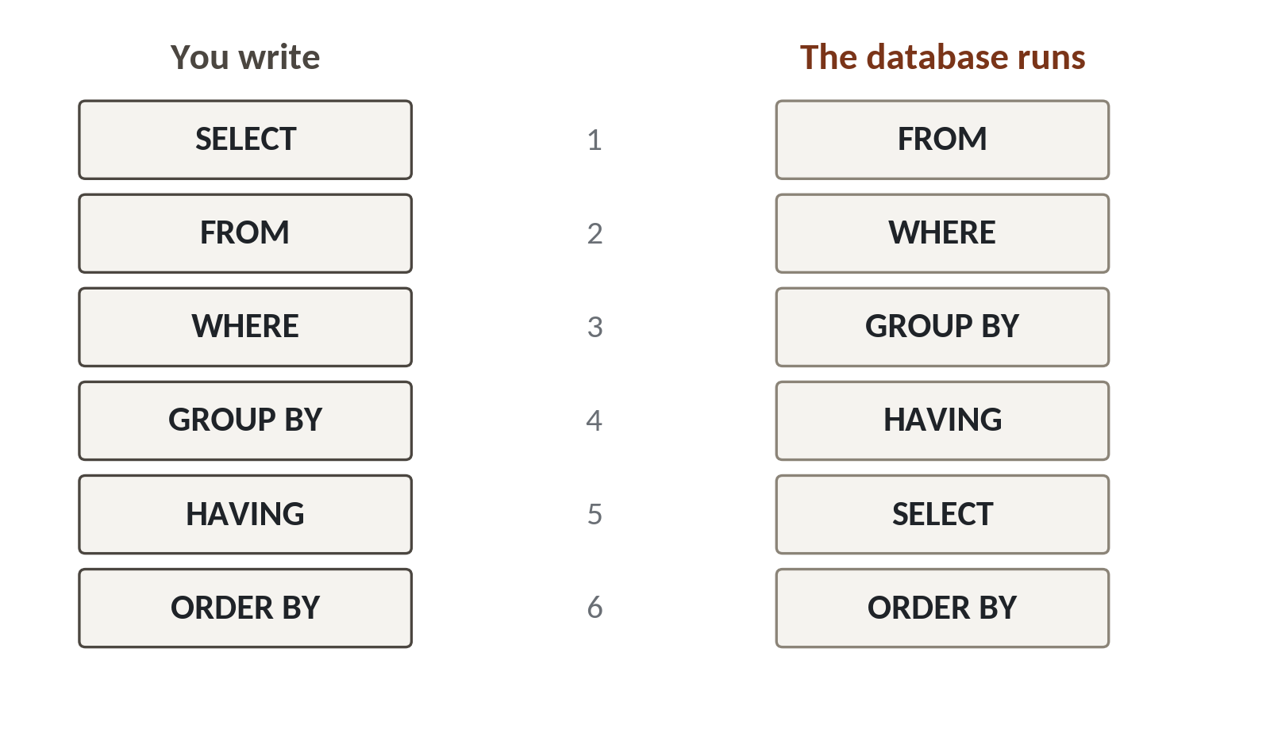
You write SQL in one order and the database runs it in another
1
FROM runs first. The database finds the table.
2
WHERE filters rows, then GROUP BY and HAVING work on groups.
3
SELECT runs fifth, so WHERE cannot see an alias.
Written: SELECT, FROM, WHERE, GROUP BY, HAVING, ORDER BY. Run: FROM, WHERE, GROUP BY, HAVING, SELECT, ORDER BY.
Session 10 SQL for analysts
13
Notes:
This picture explains the error we just saw. On the left is the order you write the clauses. On the right is the order the database runs them.
The database starts with FROM. It picks the table before it does anything else.
Then WHERE throws away rows. After that GROUP BY makes the groups, and HAVING throws away groups. That's why HAVING can test a count, and WHERE can't.
SELECT only runs fifth. That has a surprise. In standard SQL, a short name you create in SELECT doesn't exist yet when WHERE runs. SQLite is relaxed about this, but other databases will refuse, so don't rely on it. ORDER BY comes last, which is why it can use that name.
Keep this picture. When a query gives a strange error, ask which clause ran before the thing it needs.

Slide 14
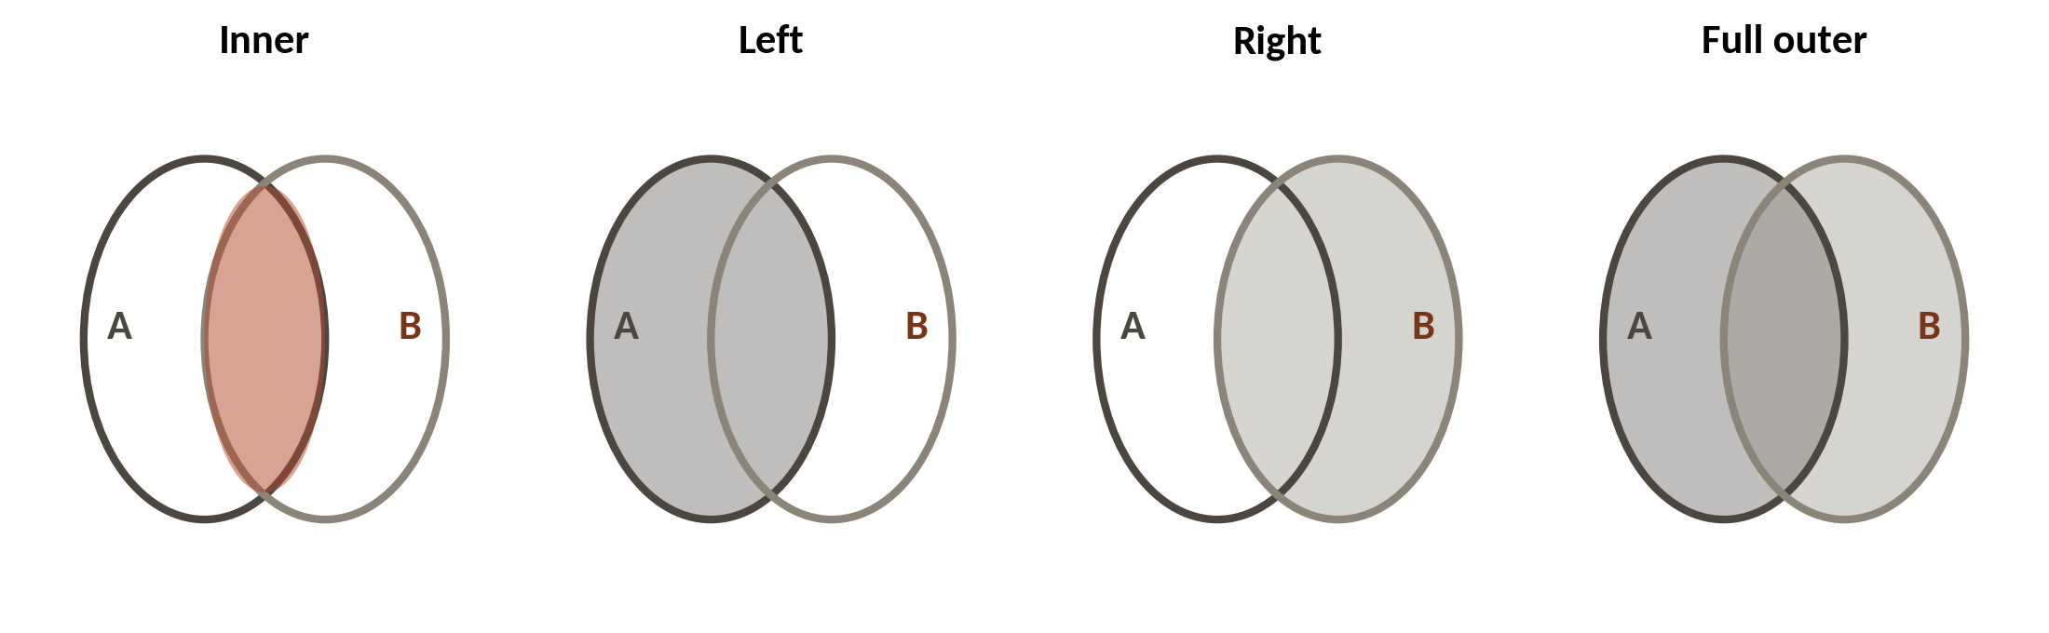
A join keeps different rows depending on its type
1
Inner keeps only the rows that match on both sides.
2
Left keeps every row of table A, matched or not.
3
Right and full outer exist too. Swap the tables and a left join does the job of a right join.
Excel twin: VLOOKUP shows #N/A for no match. A left join keeps the row. An inner join drops it.
Session 10 SQL for analysts
14
Notes:
Now the idea that connects tables. A join glues two tables together using a matching column, such as branch_id in both orders and branches. The join type decides what happens to rows that find no match.
An inner join keeps only the rows that match on both sides. Rows with no partner disappear.
A left join keeps every row from the first table, the left one, whether it matched or not. Where there's no match, the new columns are empty.
A right join is the mirror image, and a full outer join keeps everything from both sides. In practice you can swap the table order and use a left join, so we'll use inner and left today.
Think of VLOOKUP. When it finds no match you see an error. A left join keeps the row. An inner join quietly drops it, and that's the one to watch.

Slide 15
INNER JOIN adds the branch name to every order
SELECT b.branch_name,
COUNT(*) AS n_orders,
SUM(o.order_value_ugx) AS revenue
FROM orders AS o
INNER JOIN branches AS b
ON o.branch_id = b.branch_id
GROUP BY b.branch_name
ORDER BY revenue DESC
1
o and b are short aliases for the two tables.
2
ON says which columns must match.
3
Same numbers as before, now with names instead of codes.
Output
branch_name n_orders revenue
Kampala Central 5885 283331305
Kampala Ntinda 4830 238222000
Jinja 3562 176738325
Session 10 SQL for analysts
15
Notes:
Let's join. The earlier result showed branch codes. A manager wants names.
After FROM and INNER JOIN, we give each table a short alias, o for orders and b for branches. Then b dot branch_name means the branch_name column of the branches table.
ON says which columns must match. An order is joined to the branch whose branch_id is the same. In Excel, that's a VLOOKUP that brings the branch name next to each order.
The counts and revenues are identical to the earlier query. The join added names and lost no rows, because every order has a valid branch.

Slide 16
NULL
The value SQL uses for an empty cell. NULL means unknown, and it equals nothing, even another NULL.
In our data
In a spreadsheet
Walk-in customers give no loyalty number. In orders, 9,171 of 30,229 rows have a NULL customer_id.
A blank cell. Test for it with IS NULL, the way you would use ISBLANK.
Session 10 SQL for analysts
16
Notes:
One word to hold on to before the next query. NULL.
In SQL an empty cell is called NULL. It means the value is unknown. Because it's unknown, it isn't equal to anything, and it isn't different from anything either. To find it you must write IS NULL.
In our orders, walk-in customers have no loyalty number, so the customer ID is NULL. That's nine thousand one hundred and seventy one orders out of thirty thousand two hundred and twenty nine.
In Excel it's a blank cell, and the test is ISBLANK. In SQL the test is IS NULL.

Slide 17
LEFT JOIN keeps the walk-in orders
SELECT COUNT(*) AS all_orders,
COUNT(c.customer_id) AS matched
FROM orders AS o
LEFT JOIN customers AS c
ON o.customer_id = c.customer_id
1
LEFT JOIN keeps every order.
2
COUNT of one column skips NULLs, so it counts the matches.
Output
all_orders matched
30229 21058
3
An INNER JOIN here would keep only 21,058 rows.
Session 10 SQL for analysts
17
Notes:
Does every order belong to a loyalty customer? Let's find out with a left join.
LEFT JOIN keeps every order, thirty thousand two hundred and twenty nine of them. For walk-ins, the customer columns come back as NULL.
COUNT of star counts rows. COUNT of one column counts only the rows where that column isn't NULL. So the second number, twenty one thousand and fifty eight, is the orders that matched a loyalty customer.
Had we written INNER JOIN, we'd have kept twenty one thousand and fifty eight orders and lost over nine thousand without any warning. The pandas twin is merge with how equals left. Always ask which rows a join might silently remove.

Slide 18
CASE is IF for a column
SELECT CASE WHEN order_value_ugx < 20000 THEN 'Small'
WHEN order_value_ugx < 100000 THEN 'Medium'
ELSE 'Large' END AS band,
COUNT(*) AS n
FROM orders
GROUP BY band
ORDER BY n DESC
1
CASE tests each WHEN in order and uses the first that is true.
2
ELSE catches everything left.
Output
band n
Medium 14486
Small 13529
Large 2214
Session 10 SQL for analysts
18
Notes:
Sometimes you need a label that isn't in the data. Here we sort orders into small, medium and large.
CASE is the IF function from Session 6 and from Excel. It checks each WHEN in order and takes the first one that is true. Under twenty thousand shillings is small. Under a hundred thousand is medium.
ELSE catches whatever is left, which is large. Then we group by the new label and count.
Medium has fourteen thousand four hundred and eighty six orders, small has thirteen thousand five hundred and twenty nine, and large has two thousand two hundred and fourteen. The pandas twin is a function called cut, which sorts numbers into bands. You'll try it in the lab.

Slide 19
A subquery asks a question inside a question
SELECT COUNT(*) AS above_average
FROM orders
WHERE order_value_ugx >
(SELECT AVG(order_value_ugx) FROM orders)
1
The bracketed query runs first and returns one number, the average.
2
The outer query then counts orders above it.
Output
above_average
7523
Session 10 SQL for analysts
19
Notes:
How many orders are bigger than the average order? That takes two steps.
First we need the average. Then we count the orders above it. A subquery lets you write both in one statement. It's a query inside brackets, and the database runs the inside first.
The inside query returns one number, the average order value, which is about forty seven thousand five hundred shillings. The outside query counts the orders above that number.
The answer is seven thousand five hundred and twenty three, about one order in four. In Excel you'd calculate the average in a cell, then use COUNTIF against that cell. A subquery does both at once.

Slide 20
A filter that quietly drops the walk-ins
What it looks like
Why it goes wrong
The fix
You ask for all orders where customer_id is not C0495. Only 8 of 30,229 orders belong to C0495. The query returns 21,050 rows and shows no error.
NULL is unknown, so the test NULL not equal to C0495 is never true. SQL drops every walk-in order, over nine thousand rows.
Test for blanks on purpose with IS NULL or IS NOT NULL. Compare the count with the table size before you trust a filter.
Session 10 SQL for analysts
20
Notes:
Here's a trap that runs without an error. We want all orders except the ones from customer C0495.
You write WHERE customer_id not equal to C0495. The query runs. It returns twenty one thousand and fifty rows, and nothing warns you. You'd expect thirty thousand two hundred and twenty one, since only eight orders belong to that customer.
NULL is unknown. When the customer ID is unknown, the database can't say it differs from C0495, so the test isn't true and the row is dropped. Every walk-in order disappears.
The fix is to handle blanks on purpose. Write IS NULL or IS NOT NULL when they matter. And compare your row count with the size of the table. If nine thousand rows vanished, you'll see it. You'll check this one in the lab.

Slide 21
Lab: eight tasks, three answers rebuilt in pandas
1
Open the Session 10 notebook and run the setup cell
Tool and time
Google Colab
40 minutes
2
Connect to lakeside.db and list its tables
3
Write the queries: WHERE, ORDER BY, GROUP BY, HAVING, CASE
You are done when
Three SQL answers equal their pandas twins. You can say which rows a join dropped.
4
Join orders to branches
5
Rebuild three answers in pandas and compare
6
Run the walk-in trap and explain the gap
Session 10 SQL for analysts
21
Notes:
The lab is forty minutes in Google Colab. The first task is to open lakeside.db and ask SQLite to list its nine tables, so you see for yourself that a database is a workbook of sheets. Run the setup cell first.
The notebook has eight tasks and ten queries in all. Each task gives you a question, a blank for your query and a check cell.
For three of the tasks you write the answer twice, once in SQL and once in pandas, and the check cell compares them. That comparison is the skill we are building.
The last task is the walk-in trap, so you can watch nine thousand rows go missing. If a query fails, read the end of the error message and fix that clause first.

Slide 22
Questions to finish
1
A query has no ORDER BY. Can you rely on the rows coming back in the same order?
No. SQL has no row order unless you write ORDER BY.
2
You want branches with more than 4,000 orders. WHERE or HAVING?
HAVING. WHERE runs before the groups exist.
3
Which join keeps the orders of walk-in customers who have no match?
A LEFT JOIN from orders. An INNER JOIN drops them.
Session 10 SQL for analysts
22
Notes:
Three questions on SQL.
Question one. A query has no ORDER BY. Can you rely on the rows coming back in the same order? Think it over.
No. SQL has no row order unless you write ORDER BY. Write it whenever order matters.
Question two. You want the branches with more than four thousand orders. WHERE or HAVING? Give that a moment.
HAVING. WHERE runs before the groups exist, so it can't test a total.
Question three. Which join keeps the orders of walk-in customers who have no match in the customers table? Sit with it for a second.
A left join, starting from orders. An inner join drops those orders, and it does so quietly.

Slide 23
Summary
A database is several tables. SELECT, FROM and WHERE pick columns and rows. GROUP BY and HAVING are a PivotTable.
SQL has no row order unless you write ORDER BY. The database runs FROM first and SELECT fifth.
A join type decides which rows survive. NULL is unknown, so a test on it can drop rows silently.
Next session. Exploring and visualising with Python
Session 10 SQL for analysts
23
Notes:
One. A database is several tables joined by keys. SELECT, FROM and WHERE choose columns and rows, and GROUP BY with HAVING does the work of a PivotTable.
Two. SQL has no row order unless you write ORDER BY. And remember the run order, FROM first, SELECT fifth.
Three. The join type decides which rows survive, and NULL is unknown, so a filter on it can drop rows without a warning. Always compare your row counts.
Next session we make charts. Bring a question about the returns, and we'll see which branches look worst, and whether the answer changes when you count them differently.

